Slide 1
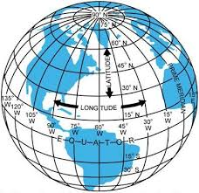
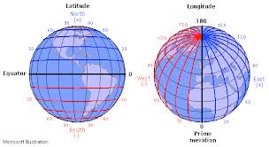
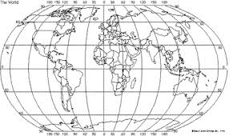
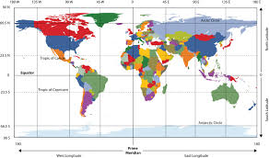
Types of Location
How do we find places on maps?

Slide 2
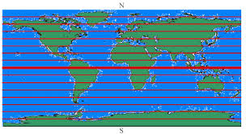
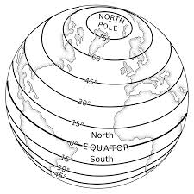
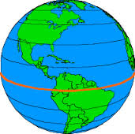
Lattitude
What is Latitude?
Lines of latitude run east and west.
Latitude is measured in degrees.
Latitude lines are also called parallels.
The Equator is at 0 degrees latitude.
Lines of latitude locate places North or South of the Equator.

Slide 3
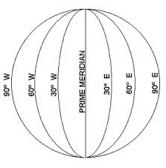
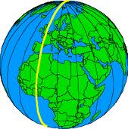
Longitude
What is Longitude?
Lines of longitude run North and South.
They are also called Meridians.
The Prime Meridian is 0 degrees longitude.
Lines of longitude locate places east and west of the prime meridian.
There are 180 degree of east longitude and 180 degrees of west longitude.

Slide 4
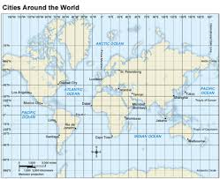
Absolute Location
Latitude and Longitude lines cross to form a grid.
Every place in the world has one exact spot on the grid.
This is called absolute location.

Slide 5
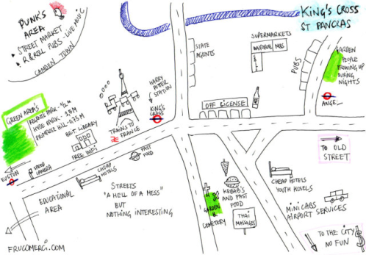
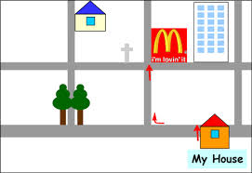
Relative Location
Another type of location is Relative Location.
It’s called relative location because you describe a location based on its relation to another spot.
For example: Subway is behind the car wash.
Ex: Ullin is north of Karnak.

